Slide 1


8th Grade Math: Pre-Algebra Unit 12, Lesson 1 Applying the Distributive Property with Variables Volume 2, pg. 217

Slide 2


Benchmark
MA.8.AR.1.2
Apply properties of operations to multiply two linear expressions with rational coefficients.
volume 2, pg. 217
Notes:
2

Slide 3
Integrated Mathematical Thinking and Reasoning Standards
MA.K12.MTR.2.1 Demonstrate understanding by representing problems in multiple ways.
MA.K12.MTR.3.1 Complete tasks with mathematical fluency.
MA.K12.MTR.7.1 Apply mathematics to real-world contexts.
volume 2, pg. 217
Notes:
3

Slide 4

Learning Target
I can write equivalent algebraic expressions by applying the distributive property.
volume 2, pg. 217

Slide 5


Warm-Up
volume 2, pg. 217
Notes:
5

Slide 6
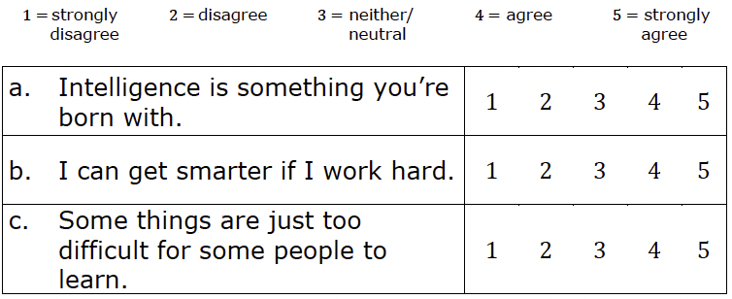
12.1.1 Warm-Up: Growth Mindset
On a scale from 1 to 5, rate each of the following statements by circling the number that matches your belief.
volume 2, pg. 217
Notes:
6

Slide 7
Which statement did you agree with most? ____
Explain why you agree with it most.
volume 2, pg. 217
Notes:
7

Slide 8

Refresher
volume 2, pg. 218
Notes:
8

Slide 9

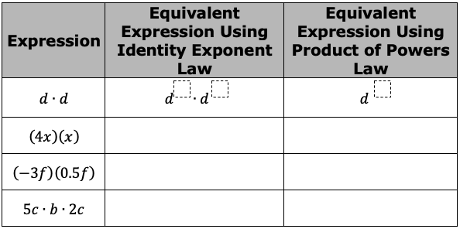
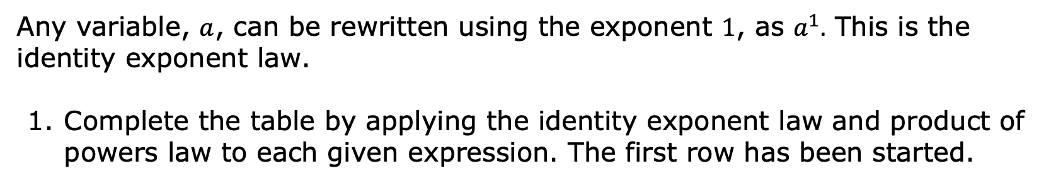
12.1.2 Refresher: Multiplying with Exponents
Any variable, $a$, can be rewritten using the exponent $1$, as $a^{1}.$ This is the identity exponent law.
Complete the table by applying the identity exponent law and product of powers law to each given expression. The first row has been started.
volume 2, pg. 218
Notes:
9

Slide 10
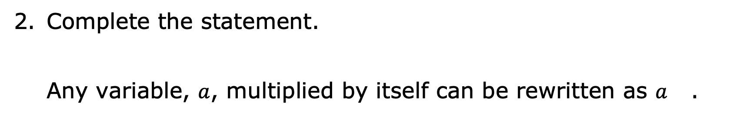
Complete the statement.
Any variable, $a$, multiplied by itself can be rewritten as $a$ .
volume 2, pg. 218
Notes:
10

Slide 11

Exploration
volume 2, pg. 218
Notes:
11

Slide 12

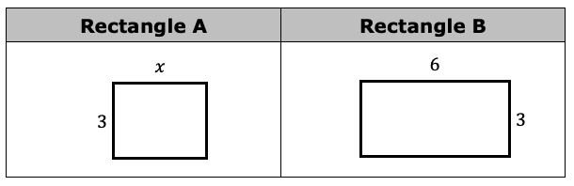
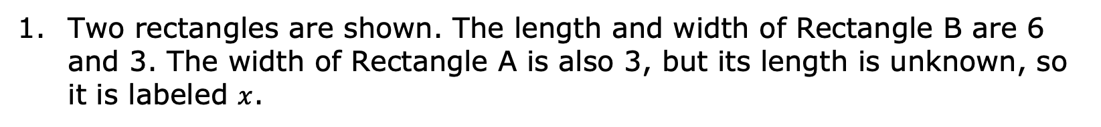
12.1.3 Exploration: Areas of Rectangles
Two rectangles are shown. The length and width of Rectangle B are 6 and 3. The width of Rectangle A is also 3, but its length is unknown, so it is labeled $x$.
volume 2, pg. 218
Notes:
12

Slide 13

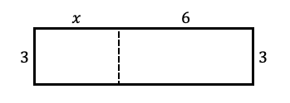
Write an expression to represent the sum of the areas of Rectangles A and B
Rectangles A and B can be composed into one larger rectangle, as shown.
Complete the statement.
The width of the new rectangle is and the length
is
3
3x
6
18
3.
(3 + x).
6.
(6 + x).
volume 2, pg. 218
Notes:
13

Slide 14
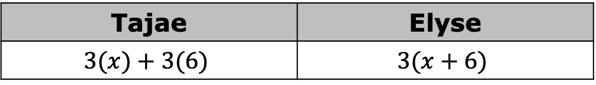
Tajae and Elyse wrote different expressions to represent the area of the larger rectangle.
Tajae | Elyse
$$3(x)+3(6)$$ | $$3(x+6)$$
Discuss with your partner whether Tajae, Elyse, or both students wrote a correct expression of the area.
Write another expression to represent the area of the larger rectangle.
volume 2, pg. 219
Notes:
14

Slide 15
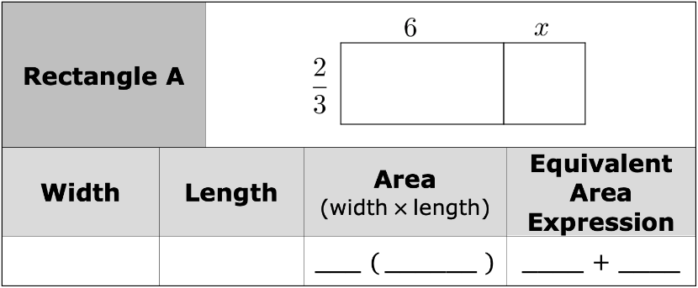
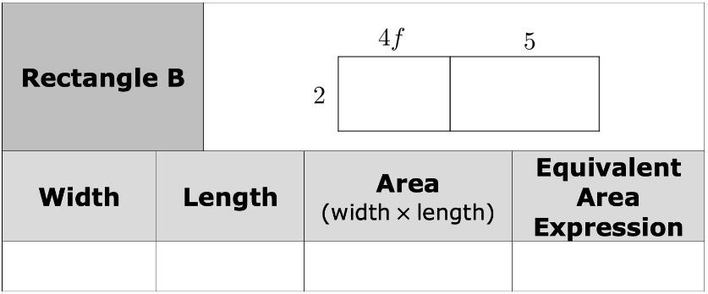
For each rectangle, complete the table.
In the first two columns, write an expression to represent the width and length of the rectangle. Then, in the next two columns, express the area of the rectangle in two different ways using either multiplication or addition.
volume 2, pg. 219
Notes:
15

Slide 16
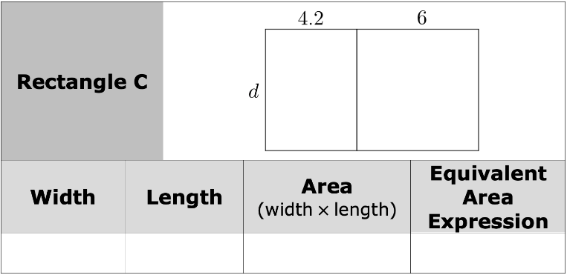
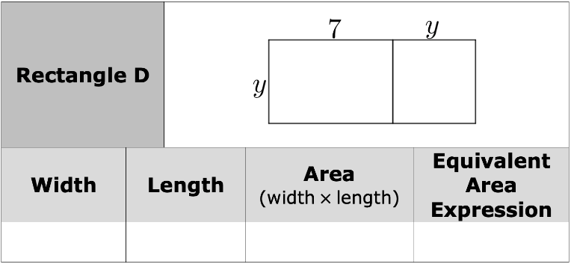
For each rectangle, complete the table.
In the first two columns, write an expression to represent the width and length of the rectangle. Then, in the next two columns, express the area of the rectangle in two different ways using either multiplication or addition.
volume 2, pg. 219
Notes:
16

Slide 17

Bring It Together
volume 2, pg. 220
Notes:
17

Slide 18

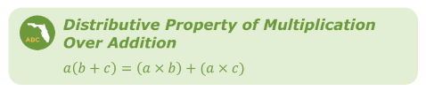
12.1.4 Bring It Together: Distributive Property
The area models used throughout the Exploration demonstrate the distributive property of multiplication over addition.
The factor outside of parentheses is “distributed” to each part of the factor within a set of parentheses. With the distributive property, multiplication is performed over (before) addition or subtraction.
Discuss with your partner how multiplication being performed before addition or subtraction relates to the order of operations.
volume 2, pg. 220
Notes:
18

Slide 19

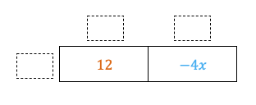
Consider the example that shows the application of the distributive property to multiply.
Complete the area model to represent the same expressions by filling in the blanks for each factor.
Discuss with your partner how the area model shows the distributive property.
volume 2, pg. 220
Notes:
19

Slide 20
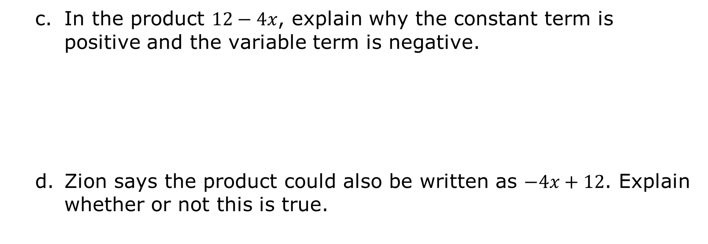
In the product $12−4x$, explain why the constant term is positive and the variable term is negative.
Zion says the product could also be written as $−4x+12$. Explain whether or not this is true.
volume 2, pg. 220
Notes:
20

Slide 21

The distributive property can also be used to multiply algebraic expressions where variables are included in both factors. An example is shown.
volume 2, pg. 220
Notes:
21

Slide 22
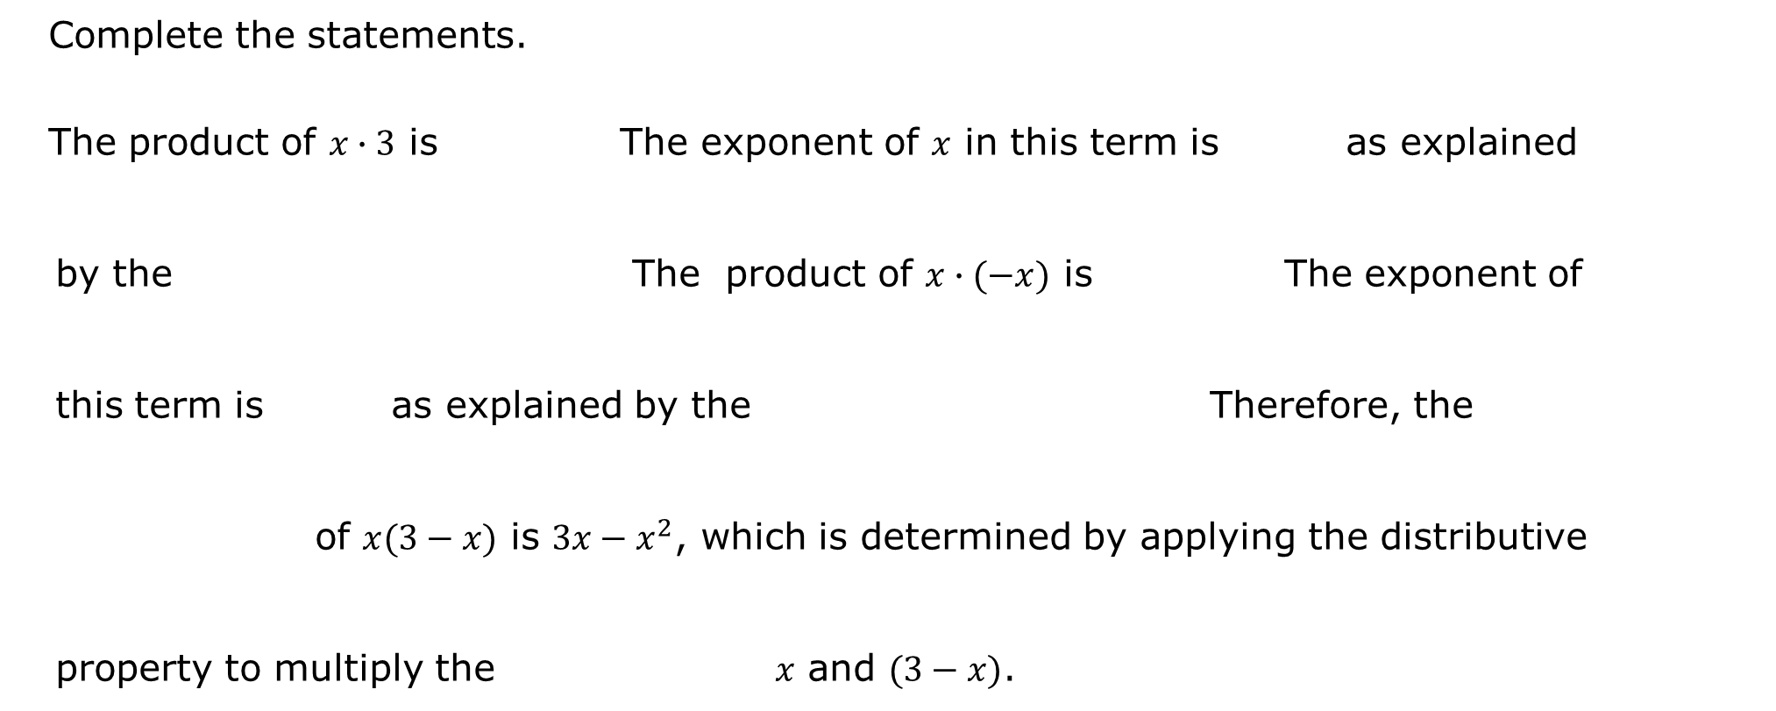
Complete the statements.
The product of $x∙3$ is The exponent of $x$ in this term is as explained by the The product of $x∙(−x)$ is The exponent of this term is as explained by the Therefore, the of $x(3−x)$ is $3x−x^{2}$, which is determined by applying the distributive property to multiply the $x$ and $(3−x)$.
3x.
⎻ x ^{2.}
1
2
identity exponent.
product of powers.
3x .
⎻ x ².
2
1
identity exponent.
product of powers.
factors
product
factors
product
volume 2, pg. 220
Notes:
22

Slide 23

Guided Practice
volume 2, pg. 221
Notes:
23

Slide 24

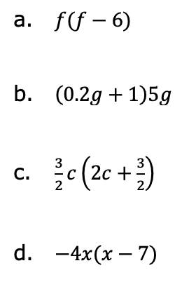
12.1.5 Guided Practice: Distributing Terms with Variables
Generate an equivalent algebraic expression for each given expression by applying the distributive property.
volume 2, pg. 221
Notes:
24

Slide 25
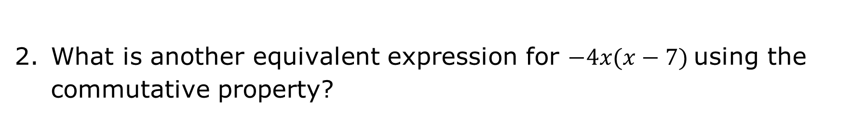
What is another equivalent expression for $−4x(x−7)$using the commutative property?
volume 2, pg. 221
Notes:
25

Slide 26

Wrap-Up
volume 2, pg. 221
Notes:
26

Slide 27
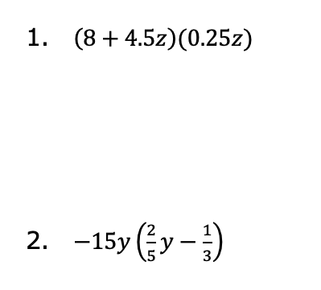
12.1.6 Wrap-Up: Ticket Out the Door
Rewrite each expression using the distributive property.
volume 2, pg. 221
Notes:
27

